Slide 1

Red Hat OpenShift Container Storage
Persistent data services for OpenShift - Open Hybrid Cloud
Sudhir Prasad, Product Management
Annette Clewett, Senior Solution Architect
Karena Angell, Product Marketing

Slide 2
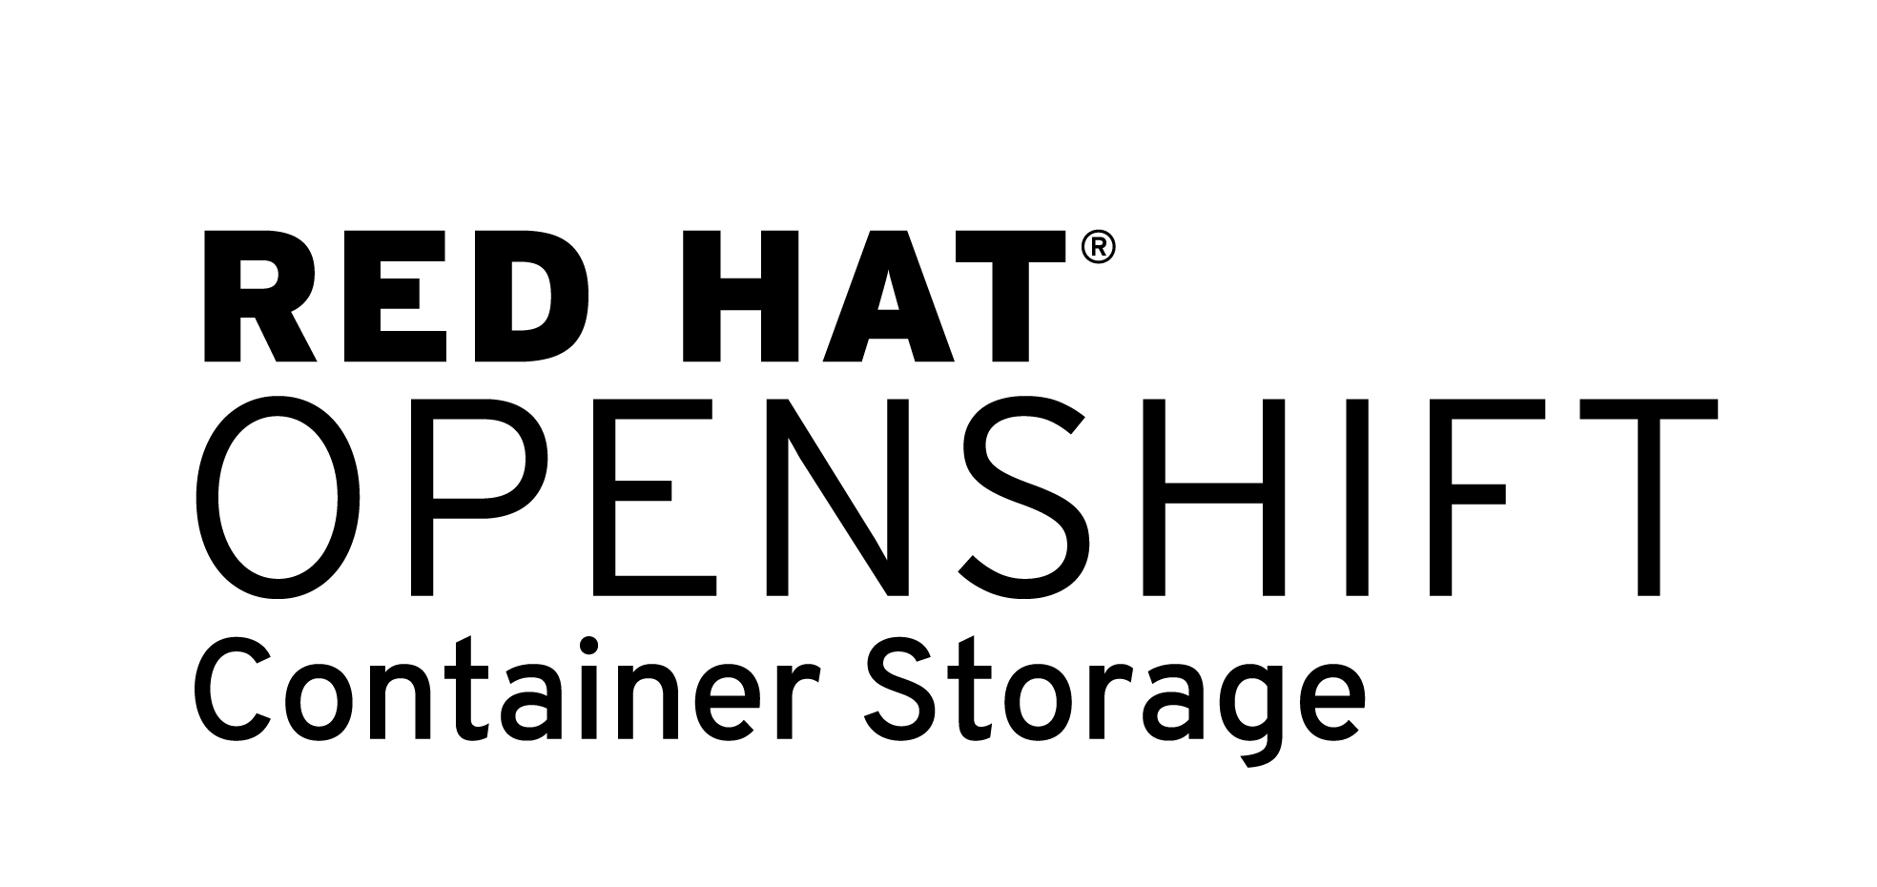
Presentation Outline
OCS - What & Why
OCS 4 - Direction, Plans, Timelines
OCS 3 to OCS 4 transition

Slide 3
Red Hat OpenShift Container Storage
What & Why

Slide 4
What is it?
Add-On for OpenShift for running stateful apps
Highly scalable, production-grade persistent storage
For stateful applications running in Red Hat® OpenShift
Optimized for Red Hat OpenShift Infrastructure services
Developed, released and deployed in synch with Red Hat OpenShift
Supported via a single contract with Red Hat OpenShift
Complete persistent storage fabric across hybrid cloud for OCP

Slide 5







Why do you need persistent Storage?
OCP Infrastructure
OCP Application
Local/Ephemeral Storage
Registry
Service 1
Metrics
Prometheous
Logging
Service 2
OpenShift Container Storage Focus
RWX/RWO backed by File, Block, S3

Slide 6

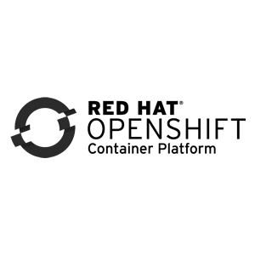













EXPLOIT THE FULL POWER OF OPENSHIFT
ANY CLOUD. ANY APP. NO LOCK IN
Future Proof against cloud or infrastructure lock-in
.
consistent storage consumption, management, and operations
RED HAT OPENSHIFT CONTAINER STORAGE
BARE METAL
VIRTUAL MACHINES
CONTAINERS
HYBRID CLOUD
LEGACY STORAGE

Slide 7











Complete Storage for Container Platform
RWO - Block
RWX - File
Object S3
RED HAT OPENSHIFT CONTAINER STORAGE
BARE METAL
VIRTUAL MACHINES
CONTAINERS
PUBLIC CLOUD
LEGACY STORAGE
AWS, AZURE, GCP
Provides Storage for All Apps and infrastructure Services
in their native interfaces

Slide 8



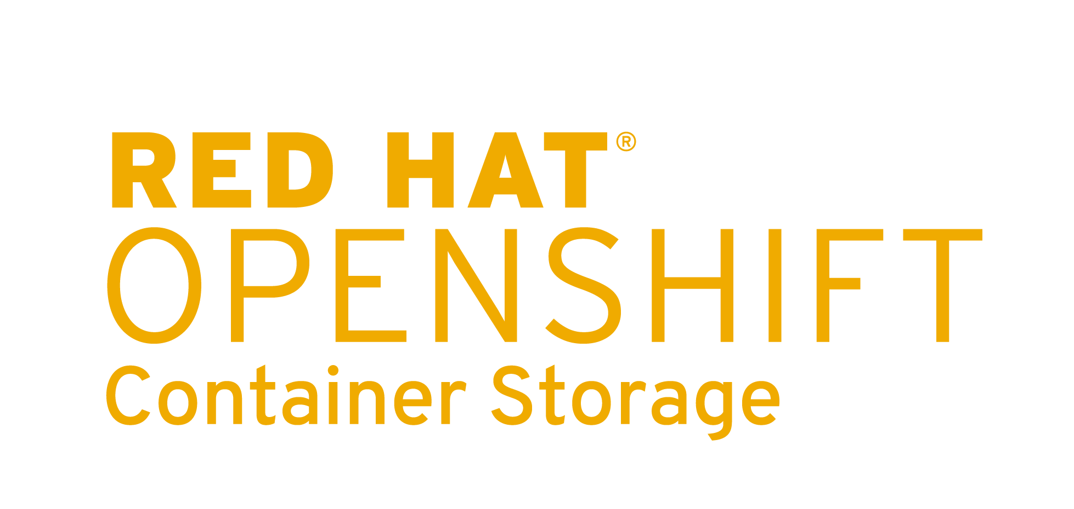
TWO FLAVORS OF CONTAINER STORAGE
Flexibility in Deployment
OPENSHIFT CONTAINER STORAGE INDEPENDENT MODE
OPENSHIFT CONTAINER STORAGE CONVERGED MODE
Use existing investment in traditional storage, managed by storage admin – attach to standalone storage
OCS 4.3
Highly scalable, enterprise-grade storage,
fully integrated into OpenShift Container Platform
OCS 4.2

Slide 9
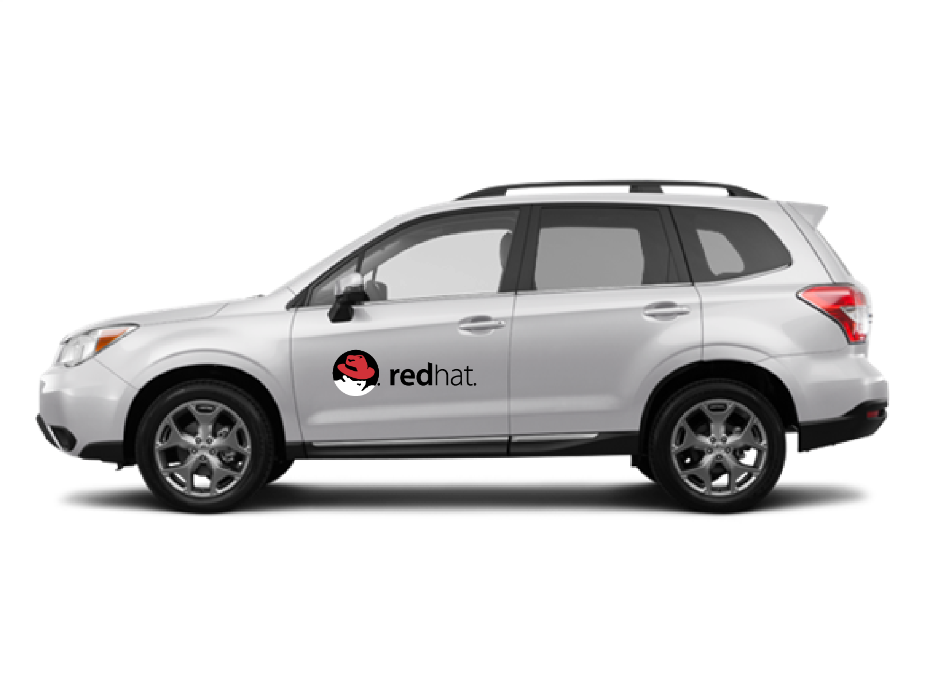
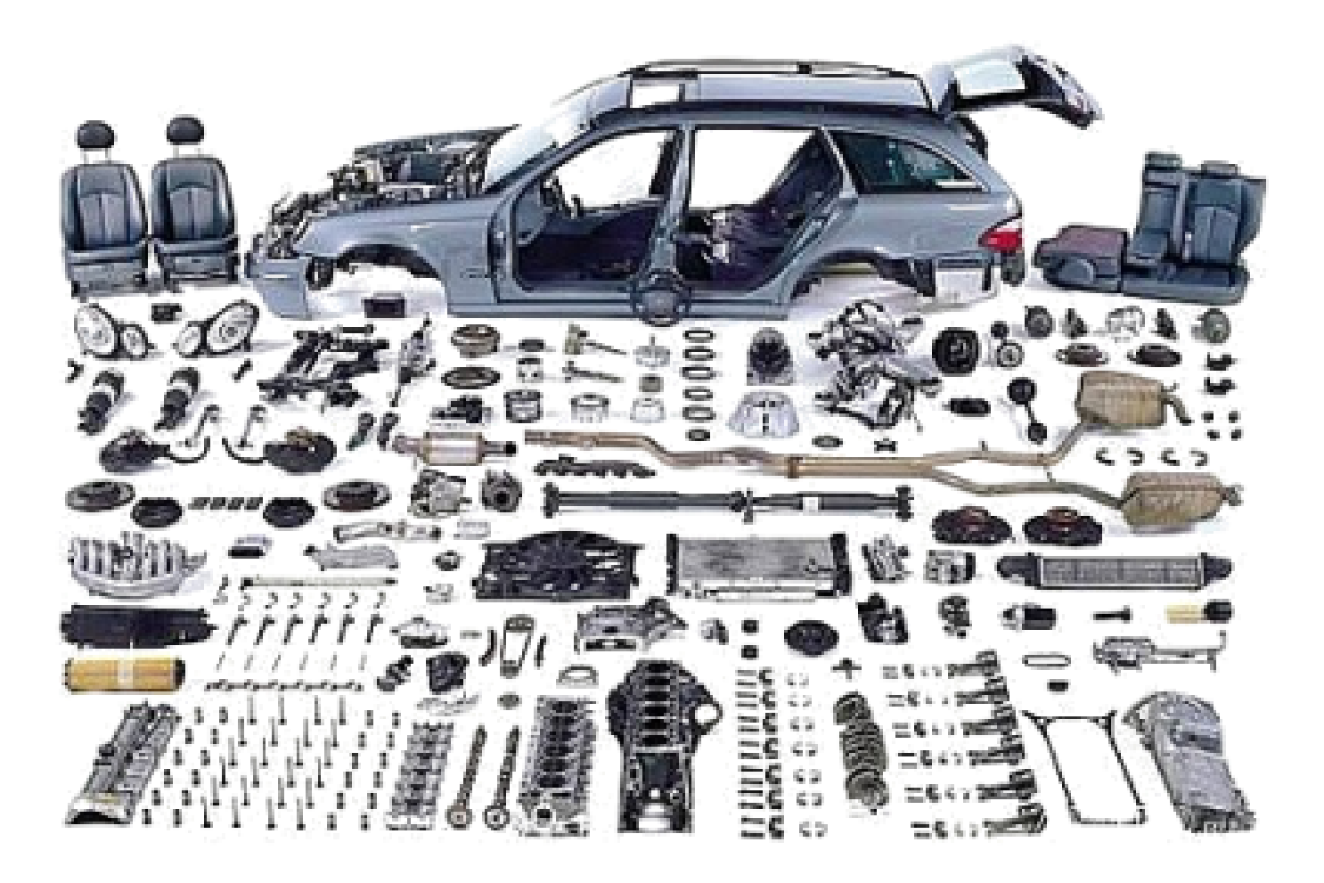
CONTAINER PLATFORM - COMPLETE FROM Red Hat
UNIFIED CLUSTER | COMPLETE PLATFORM | INTEGRATED & TESTED SINGLE VENDOR | UPGRADE & SCALE | SINGLE POINT OF SUPPORT

Slide 10


VALUE PROPOSITION BY PERSONA
OPENSHIFT CUSTOMERS
DEVELOPERS
BUSINESS LEADERS
OPERATIONS
OCP + OCS
Complete Platform
Complete Storage
Infrastructure Agnostic
Consistent Operation across Hybrid Cloud
Manage & Monitor
OCP + OCS together
Consistent Consumption Experience
Invisible Infrastructure
Complete Platform from Red Hat
Single Vendor
No Lock-in

Slide 11
Red Hat OpenShift Container Storage
Direction & Timeline

Slide 12




OCS 4 Technology Stack

Slide 13
RHOCS 4.x Roadmap
OCS 4.2 GA - Converged Mode
Operator driven install, expand, upgrade
PV’s backed by RWX, RWO, S3 for apps
AWS, VMWare, & RHHI.Next
OCP + OCS monitoring and management
Multi Cloud Data Portability/Hybrid Cloud with S3 compatible API
Nov 19
Aug/
Sep 19
OCS 4.3* - Independent Mode
Azure, Bare Metal
Data Services
Data Portability/Hybrid Cloud
Dec 19/Jan 20
OCS 4.2 Beta

Slide 14



OCS 4.X - Focus Areas
EASE OF USE
HYBRID CLOUD
& DATA SERVICES
STORAGE ENHANCEMENTS

Slide 15
Ease of Use
Hybrid Cloud
Kubernetes Storage

Slide 16
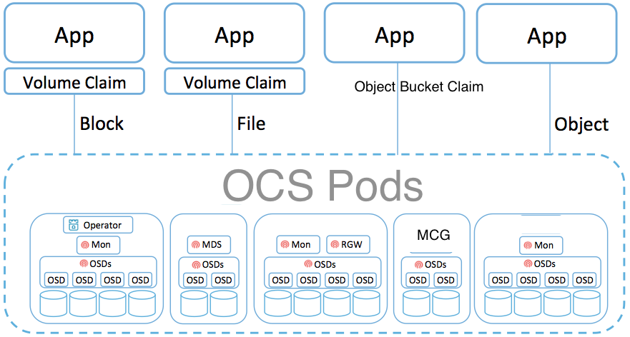

OCS 4.x Operator Install, Upgrade, Expansion
OCS Operator based on Rook.io with Operator Lifecycle Manager (OLM)
Object Bucket Claim

Slide 17
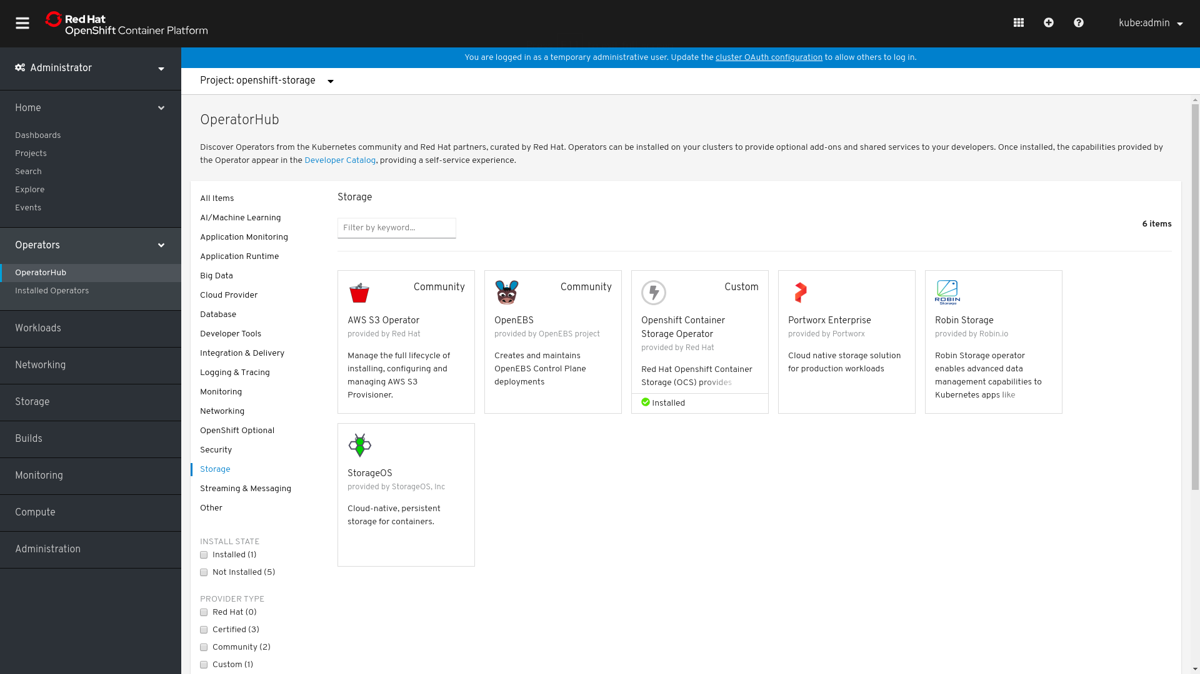

OCS 4.x Operator Driven Install from OLM
OCS Operator

Slide 18
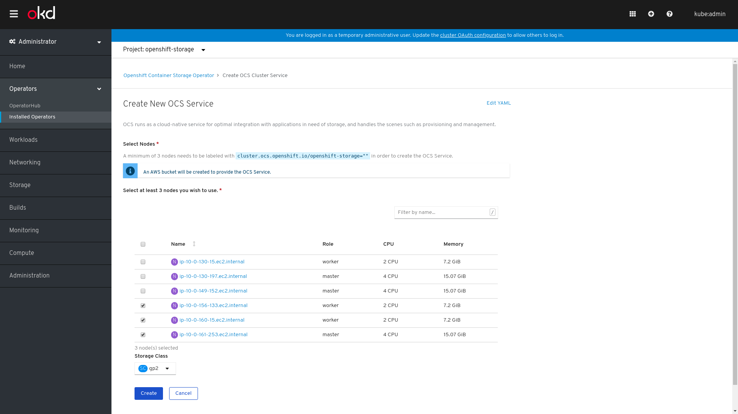
OCS 4.x Simple Install

Slide 19
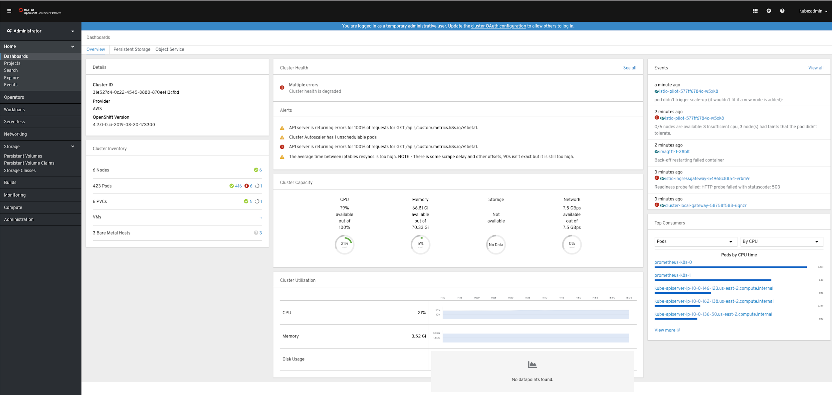
OCP + OCS Integrated Monitoring and Management
OCS Dashboard

Slide 20
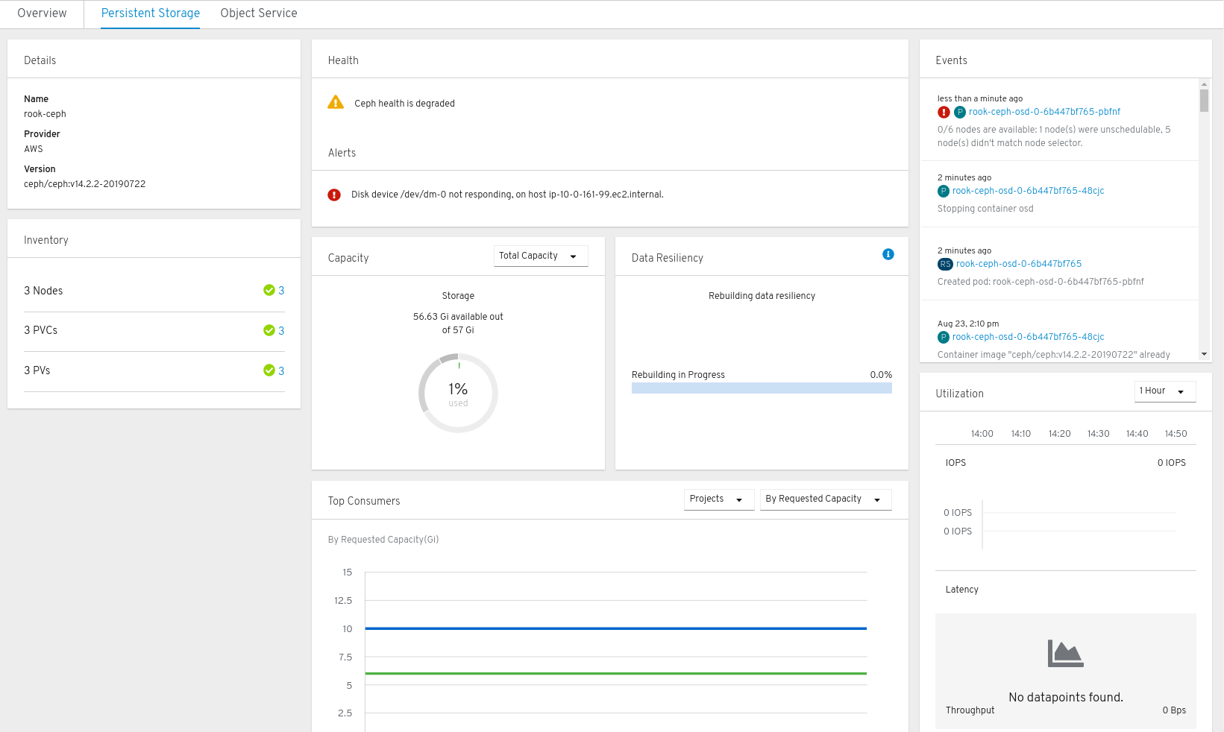
OCS Integrated Dashboard
Health, Capacity, Performance, Configuration, Alerts

Slide 21
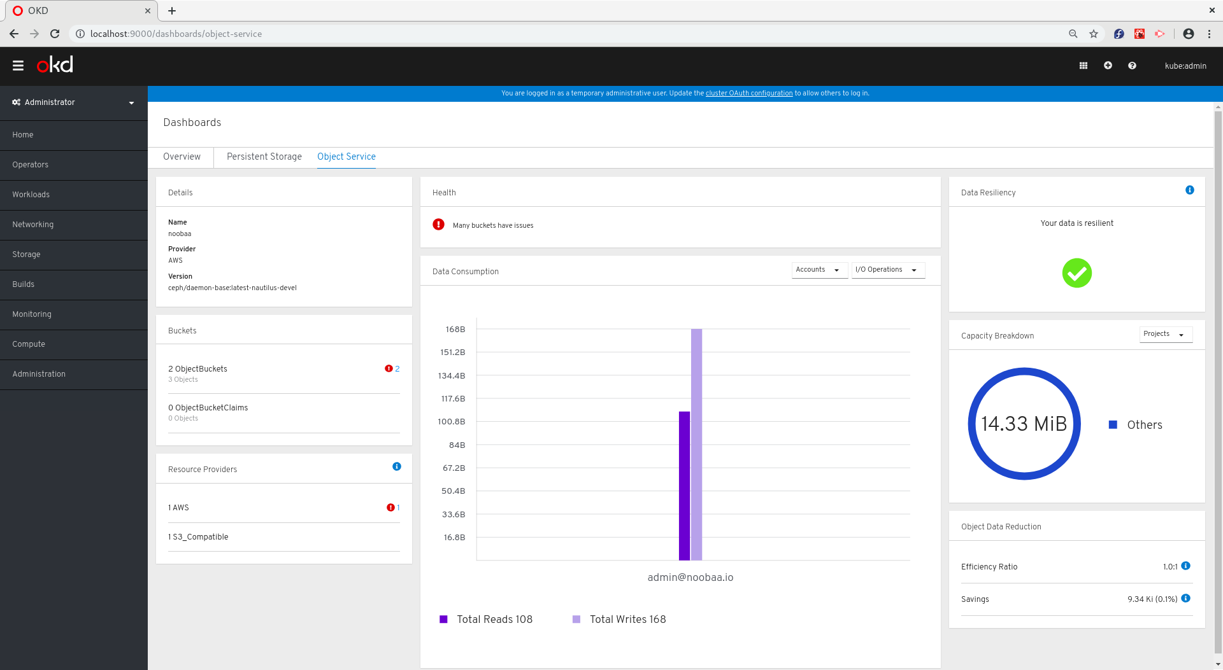
OCS Integrated Dashboard - Object Storage
Monitoring and Alerts

Slide 22
Ease of Use
Hybrid Cloud
Kubernetes Storage

Slide 23



Red Hat OpenShift Container Storage Consistent Set of OpenShift Stateful Service
OCP + OCS
OPENSHIFT CONTAINER STORAGE
The 2nd episode!
ON-PREM
PUBLIC CLOUD
OPEN HYBRID CLOUD IMPERATIVES
Application Portability | Platform Independence | Elastic

Slide 24
Complete Storage for Container Platform
RWO - Block
RWX - File
Object S3
RED HAT OPENSHIFT CONTAINER STORAGE
BARE METAL
VIRTUAL MACHINES
CONTAINERS
PUBLIC CLOUD
LEGACY STORAGE
AWS, AZURE, GCP
Addition of Object S3 completes the storage stack
OCS- MCG (Noobaa) backed by RGW or cloud native S3

Slide 25







Multi-Cloud Object Gateway (NooBaa)
App
App
App
S3 API
RED HAT OPENSHIFT CONTAINER STORAGE
Multi-Cloud Bucket
Multi-Site Bucket
Hybrid Bucket
Active - Active Multi Cloud Read /Write, First Iteration

Slide 26
Ease of Use
Hybrid Cloud
OpenShift/Kubernetes Storage

Slide 27




OpenShift Storage - CSI
4.0
OCS 4.2
Kubernetes
Kubernetes
Container Storage Interface
Updated Storage
Plugin
Storage
Operator
Storage Operator
Storage Operator
Local
Storage
Plugin
Snapshot
Plugin
Storage
Plugin
Independant
Update

Slide 28
OpenShift 4.1
OpenShift 4.2
OpenShift 4.2+
Storage Operators
Platform support: AWS EBS, Hostpath, iSCSI, FC, NFS, vSphere, AWS EFS (Dev Preview)
Container Storage Interface 1.0 GA
CSI drivers
CSI Test/Certification API Test Suite
Local Storage Operator
Raw Block
OCS integration and support
Platforms: Azure, GCP
Snapshot and Restore
Clone
PV Resize

Slide 29
Red Hat OpenShift Container Storage
Getting Started with 3.11

Slide 30
OPENSHIFT CONTAINER STORAGE 3.11.x ROADMAP
OCS 3 ROADMAP
OCS 3.11.3
June 2019
Optimized container images
limit # of volumes
2TB block volumes
Block stability fixes
Re-base to RHGS 3.5
2000 + PV gluster-file volumes
PVC names > 63 characters
quota configuration
Improved Block performance
RHOCS 3.11.4
October 2019
OCS 3.11 same lifecycle as OCP 3.11
No change in SKU or pricing
Notes:
https://access.redhat.com/support/policy/updates/openshift/
Keep selling OCS 3!
3.11.4 - Support 2000 PVs (up from 1000)
Block performance expected to increase by 40%
Customer feedback - 3.11.3 is incredibly stable

Slide 31
Red Hat OpenShift Container Storage
OCP 3 + OCS 3 → OCP + OCS 4

Slide 32
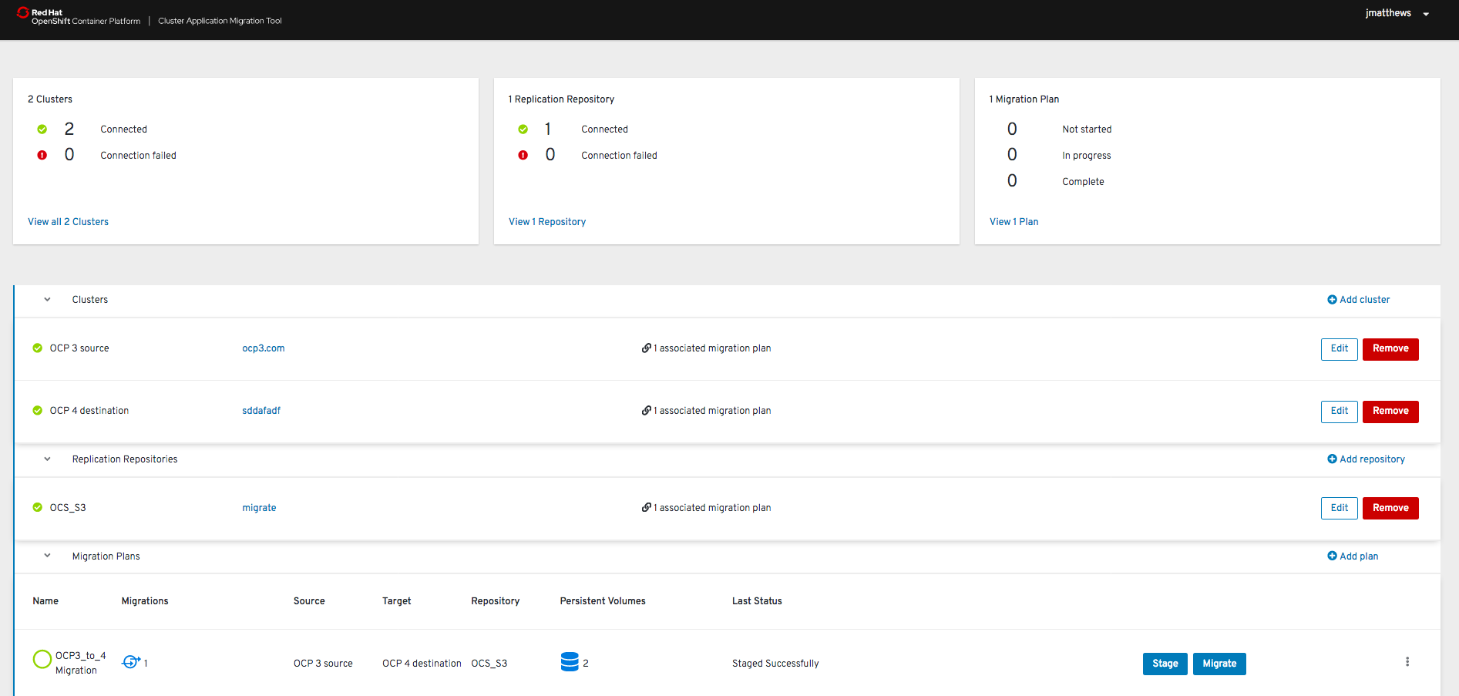
OpenShift Cluster App Migration Tool

Slide 33
Thank you
Red Hat is the world’s leading provider of enterprise open source software solutions. Award-winning support, training, and consulting services make Red Hat a trusted adviser to the Fortune 500.

